Slide 1
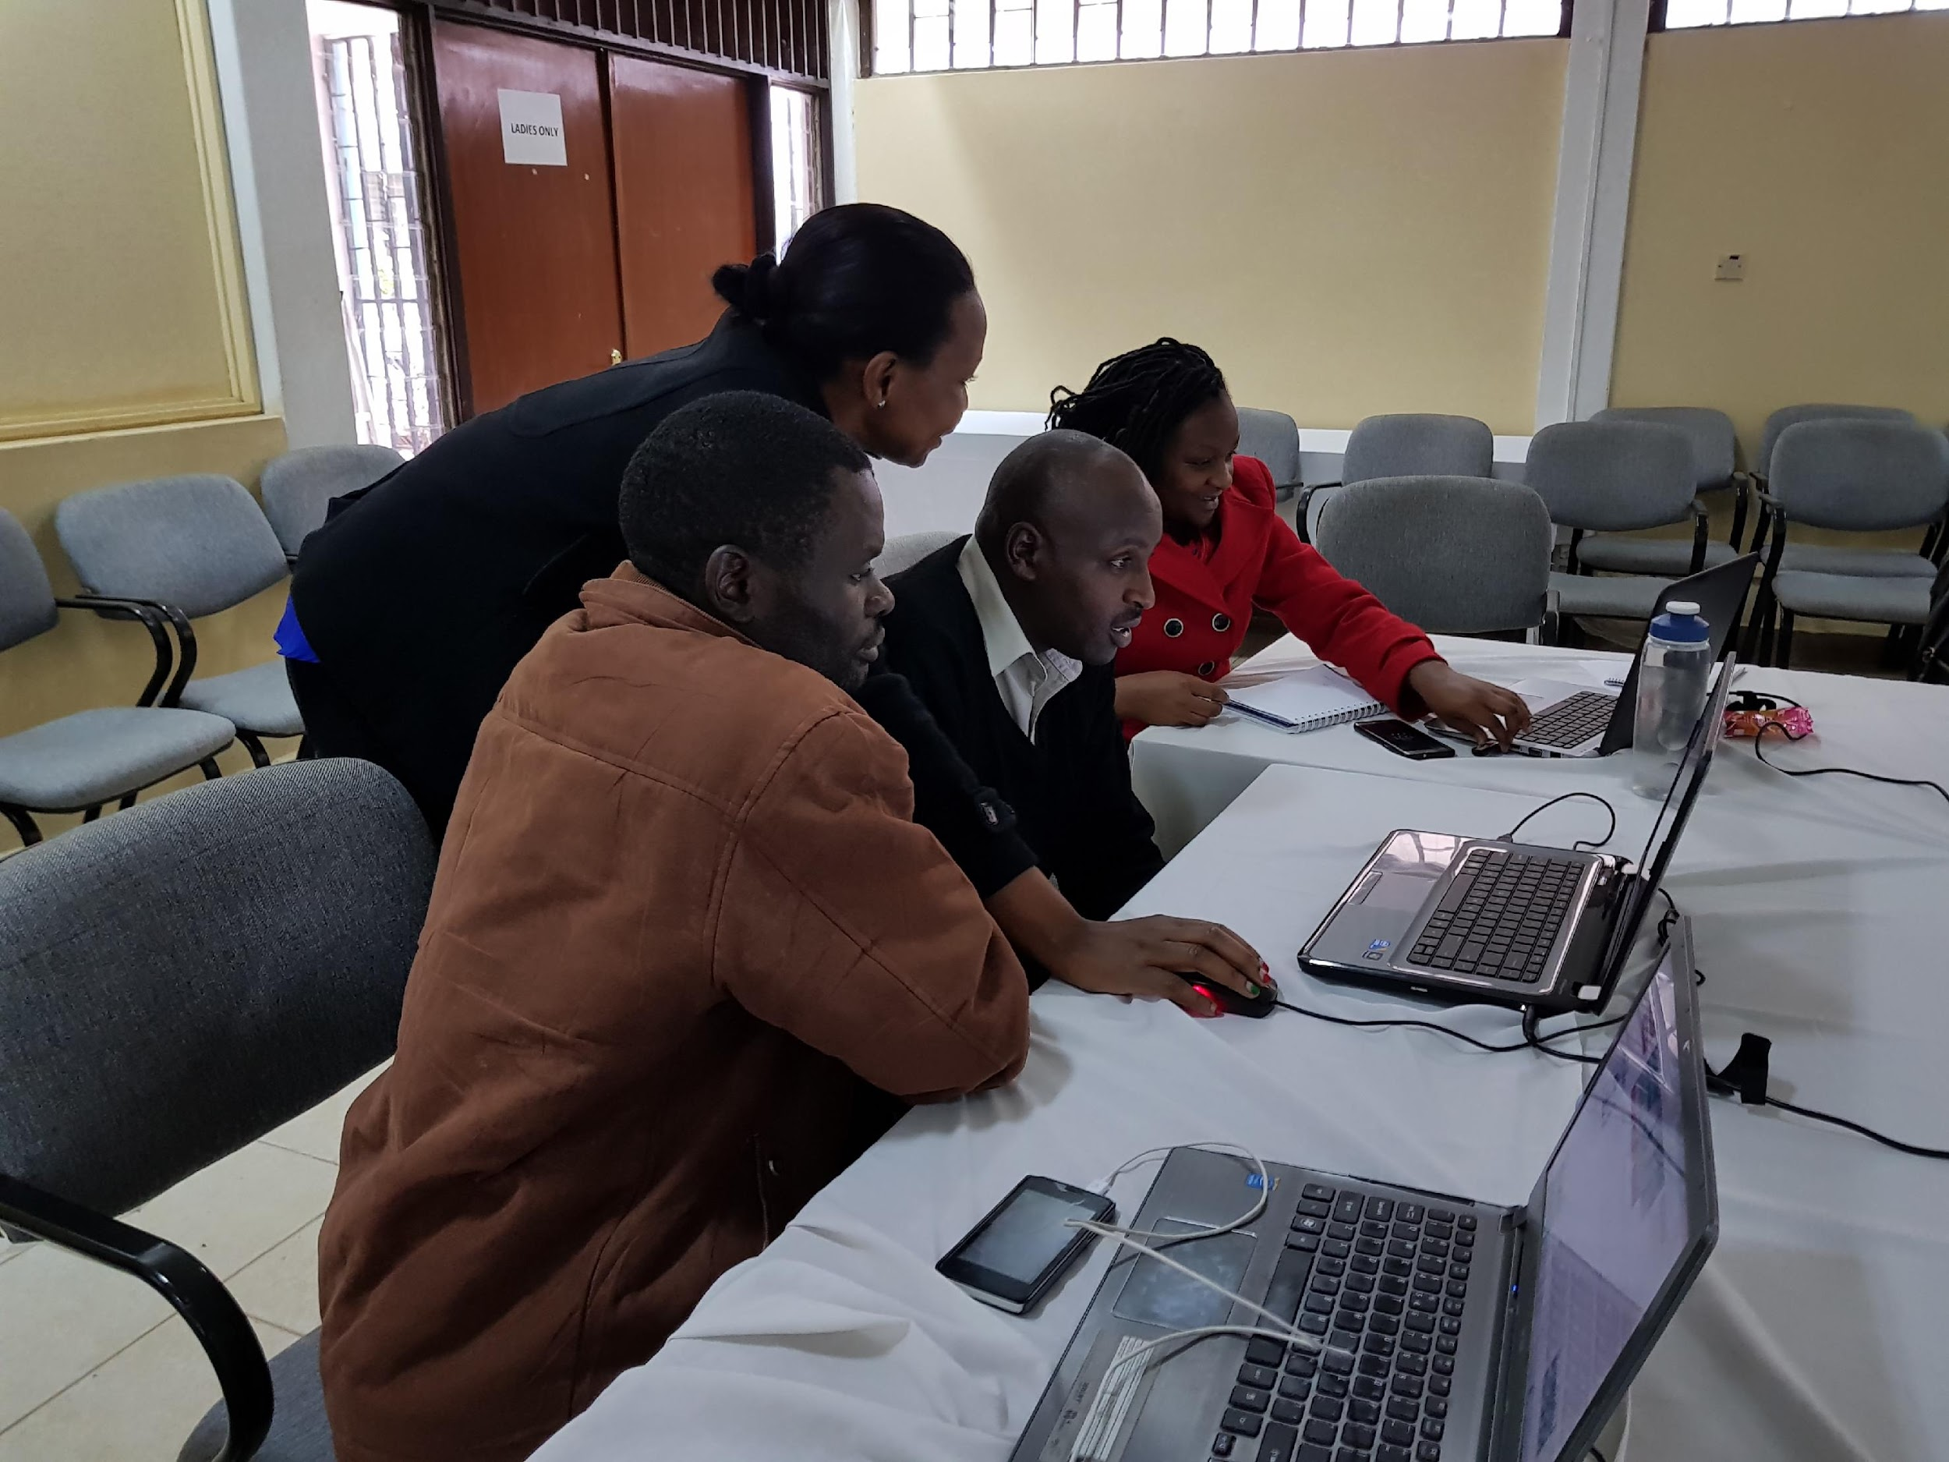
Water and Water-
Related Disasters
Regional Stream flow monitoring and forecasting
Problem specification
Eastern and Southern Africa regions face issues related to too much and too little water. As much as these issues are associated with natural phenomena like rainfall variability and rising temperatures, there are also made worse by the institutional and policies currently in place in the water sectors for developing water resources. According to the Africa Water Vision 2025 report by UNECA, a key limitation at national, sub regional and continental level to water resources development is the paucity of data on water resources. Further the paucity is attributed to the existence of weak water resources monitoring networks. This limitation is linked to inadequate human skills and capacity in the collection, assessment and dissemination of data on water resources for evidence-based water resources planning, development and management.
Highlights
“This initiative by SERVIR E&SA to help strengthen the MOWI capacity on the use of remote sensing data for stream flow monitoring is very welcome. We have been using traditional methods of manual staff gauging which comes with challenges of vandalizing and being washed away by heavy floods. Supplementation of remote sensing techniques for stream flow monitoring is very important”- Dr. Lugomela, Ag. Director, Directorate of Water resources, Ministry of Water and Irrigation, Tanzania.
Service Tracker
(check completed items on tracker)
CNA conducted in May 2016 which identified the geospatial data snd tools use challenges that exists within the varous stakeholders in carrying out their mandate effectively. Follow-ups consultations in Tanzania also conducted with the aim of refining the service. SCD has then been filled with the information to give a brief overview of what the service aims at achieving.
CNA/S
SC
PDD
TDD
DSDD
x
x
Goal Key stakeholders such as Tanzania Ministry of Water and Irrigation, Rufiji Basin Water Office and Kenya Meteorological Department are mandated to monitor water resources use, planning and conservation and provide information to the community on a timely basis. These institutions however, do not have the capacity and skills to leverage the capability of geospatial information and tools to inform on these issues, and complement the already existing in-situ monitoring tools. The main objective is therefore to develop sustainable solutions in collaboration with the key stakeholders which will involve, co-development of geospatial datasets, products and hydrological modelling tools to fill data gaps, increase the timeliness of information and dissemination and improve on water resources management practices.
Selected Indicators and Metrics
Photo: courtesy of RBWO
Indicators | Metrics
Number of people trained in climate change adaptation supported by USG assistance | 28
Number of institutions with improved capacity to address climate change issues as supported by USG assistance | 1
Number of data agreements developed/created with USG assistance | 1
Number of regional stakeholders co-developing climate mitigation and/or adaptation tools, technologies, and methodologies | 2
Theory of Change
Assumptions:
Availability of quality in-situ data for the calibration of the models
Inputs:
Geospatial data
Methodologies
Hydrological models
Training workshops
Outputs:
Stakeholders trained,
developed methodology,
Processed geospatial data,
calibrated models
Stream-flow forecasts,
Customized platform
Outcomes:
Increased provision of user-tailored geospatial data, ensemble modelling framework (EF5), calibrated models, streamflow forecasts and customized platform.
Improved capacity of stakeholders (MOWI, RBWO, KMD and MWE) to us streamflow forecasts products to make decisions on water resources management practices.
Impact:
Reduced risk of flood and drought
Key stakeholders
Decision makers: Ministry of Water and Irrigation( MOWI), Tanzania, Kenya Meteorological Department, Rufiji Basin Water Office (RBWO),TZ
Users: MOWI( TZ), RBWO(TZ), KMD(KE)
Beneficiaries: Water Users Associations, Local communities
Earth Observations / Models / Methods
The service will leverage on tools and methodologies developed in collaboration with researchers within the SERVIR network such as AST-1( Juan Valdes) and AST-2( Yang Hong), and replicate to pilot basins in Tanzania and Kenya. A multimodel, multi product approach will be used to develop stream flow forecasts products which can be used by the key stakeholders to improve their water management practices. Geospatial data such as satelite precipitation products, topographical data and other hydro-climatic data will be used in the development of the stream flow forecast products.
Immediate Next Steps
Preparation of the other service planning documents
Stakeholders consultations
Data collection and processing
Contributions from AST
AST Contributions: Co-development of tools and methodologies, Training workshops.
Accomplishments: Key stakeholders in Kenya trained on geospatial data processing and use of the developed tools for flood monitoring
next steps: Key stakeholders training on integrating developed tools into their flood monitoring systems
Beginning ARL: ___ Current ARL: ___ Final ARL: ___
Photo: KMD staff training on flood monitoring tools
Add other logos as necessary

