Slide 1
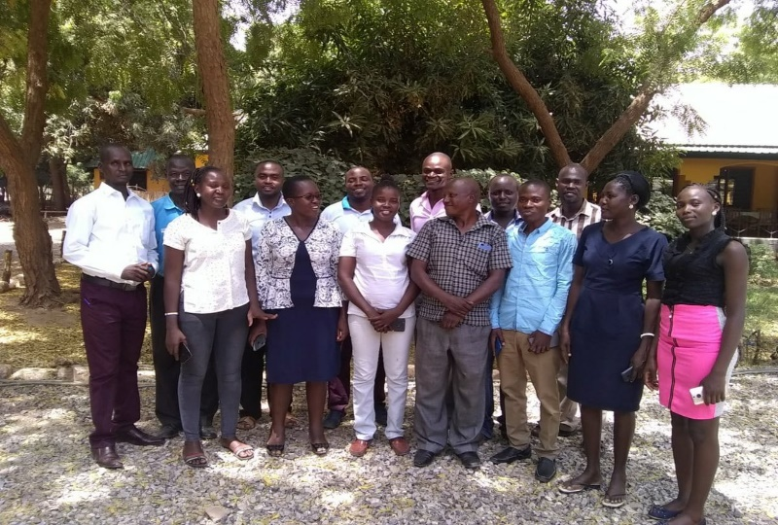
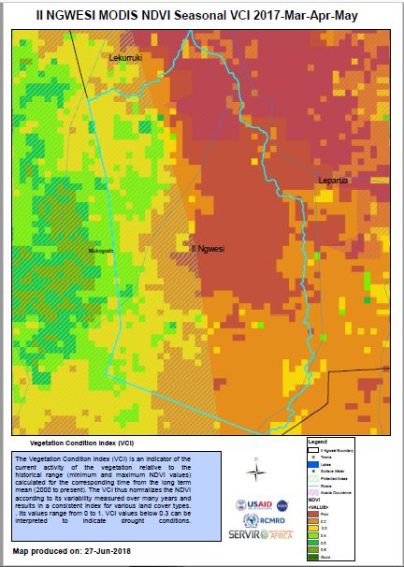
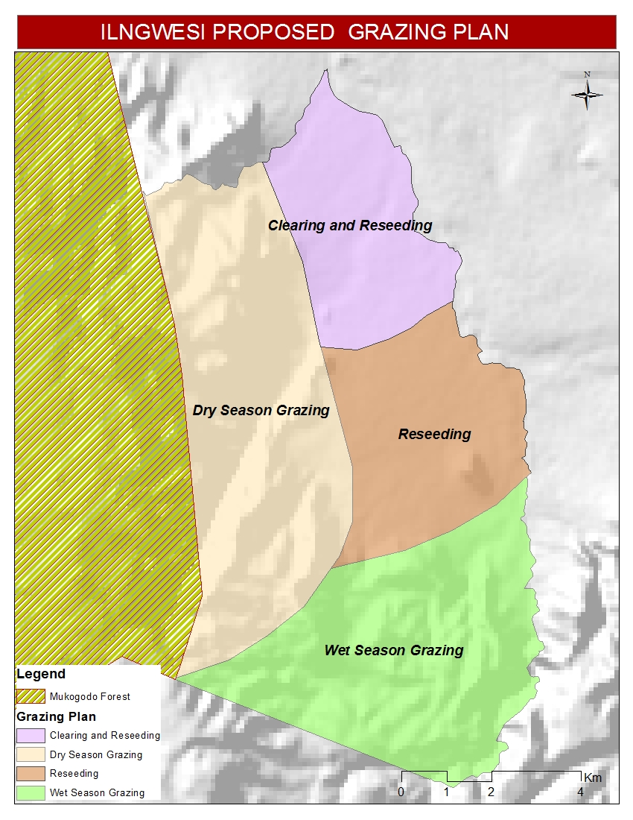
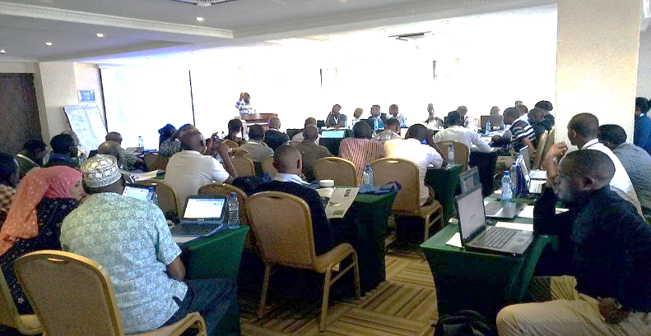
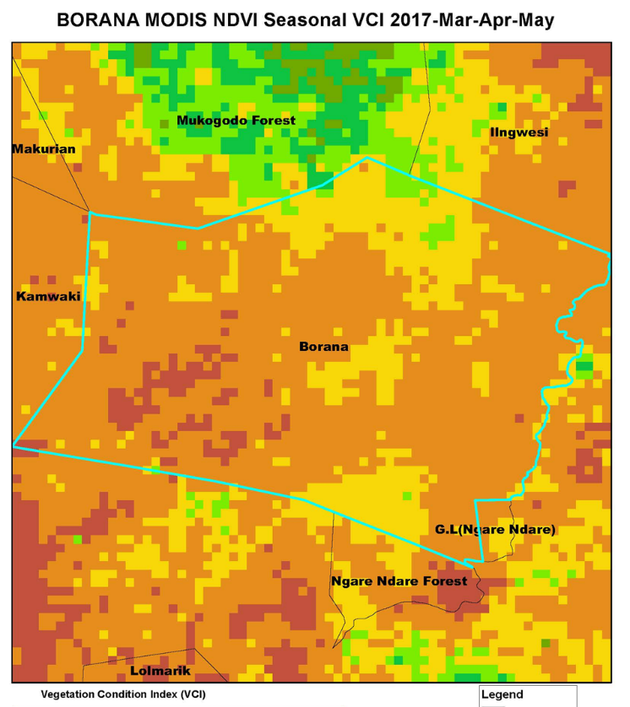
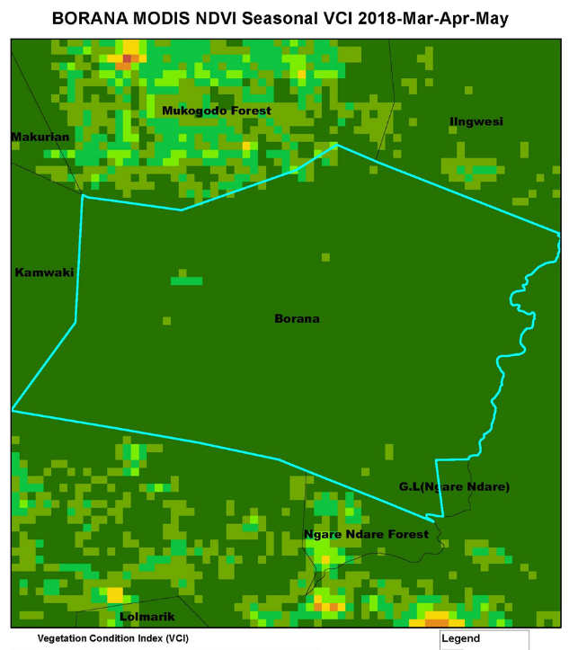
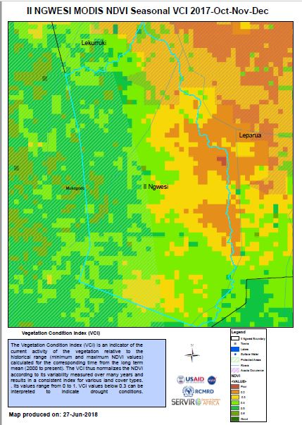
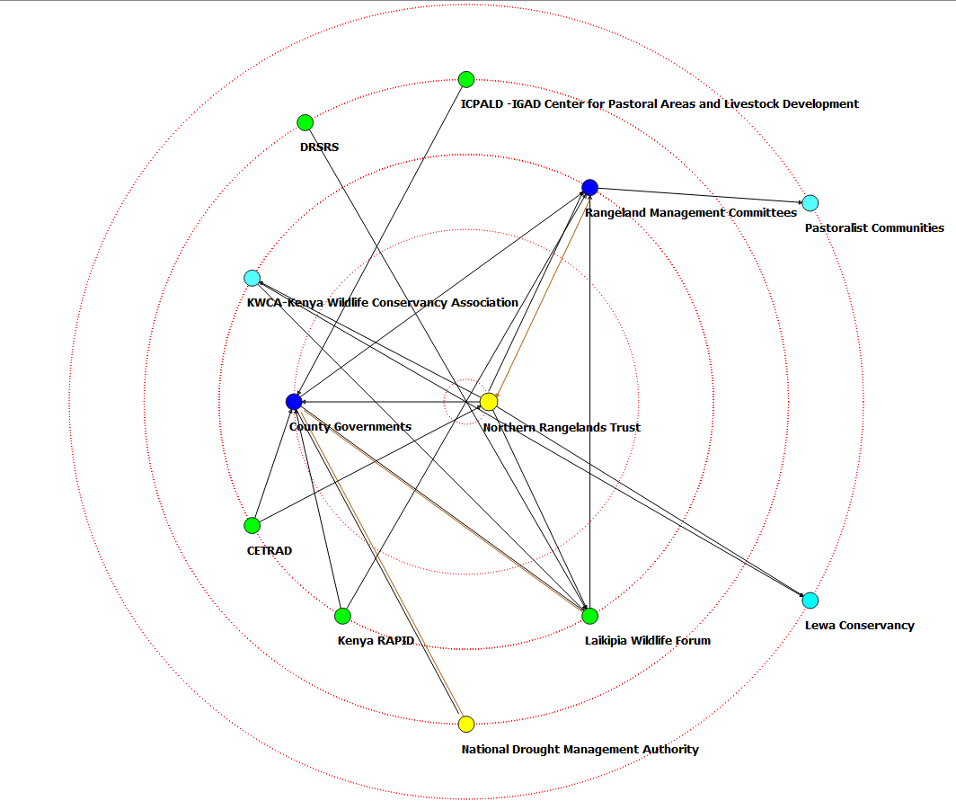
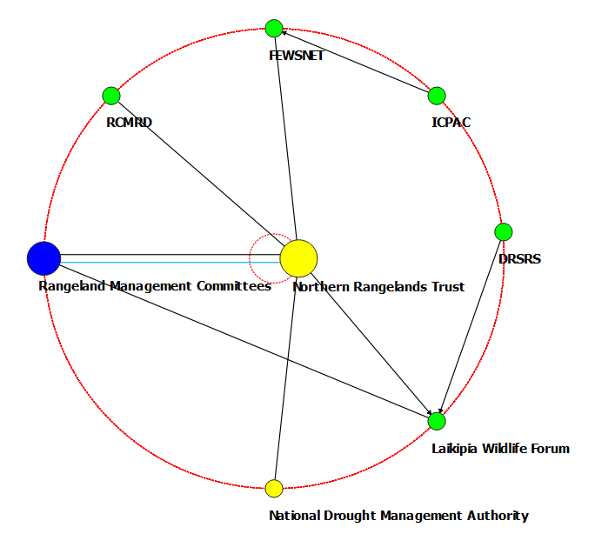
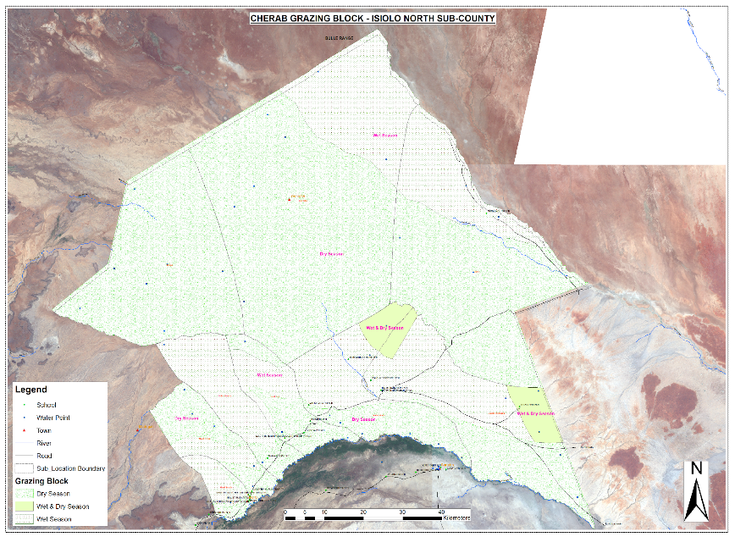
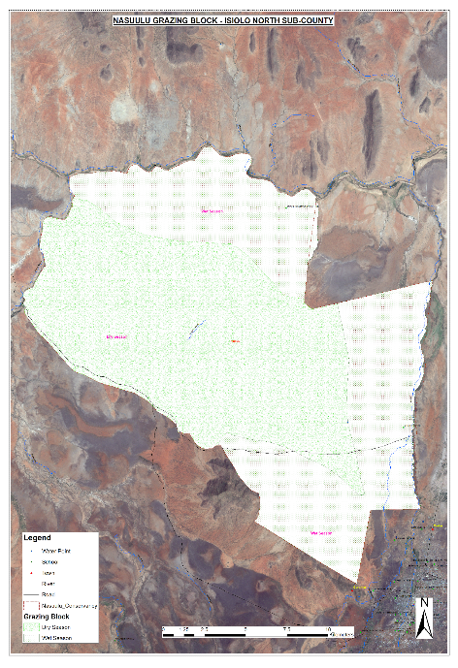
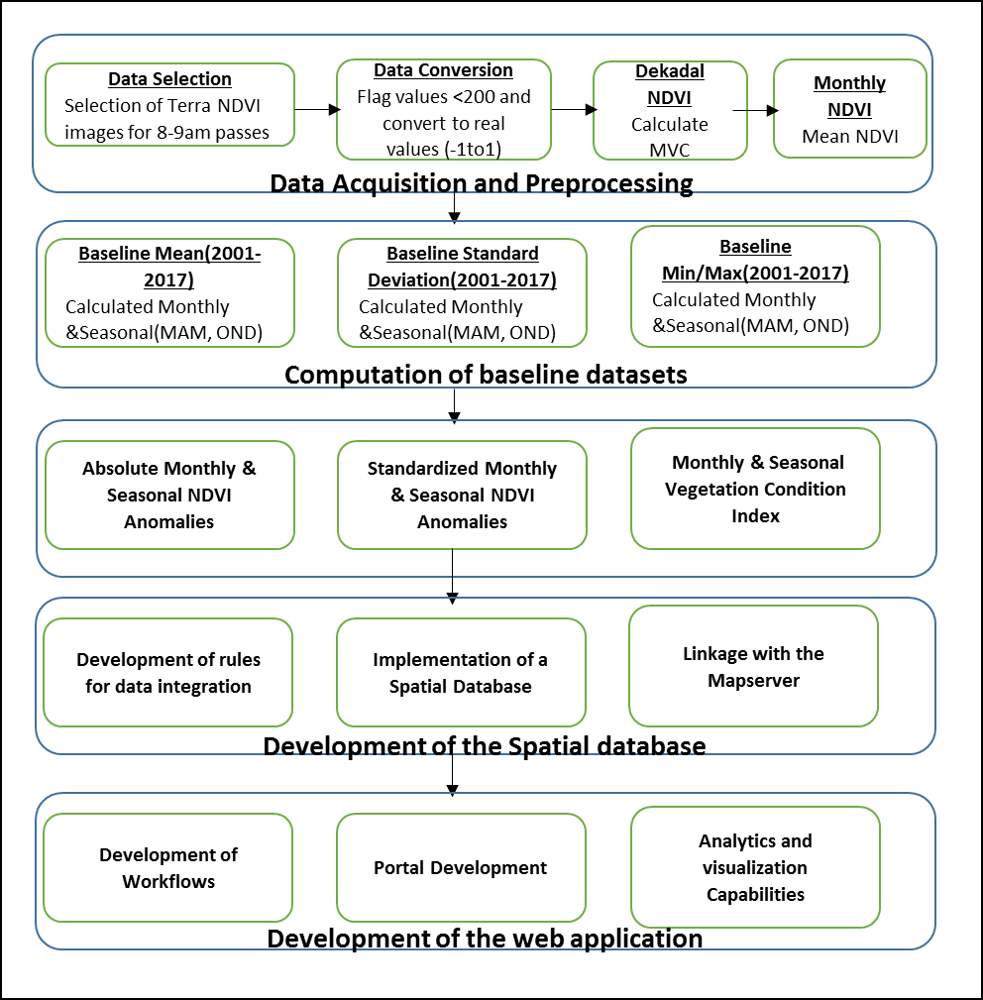
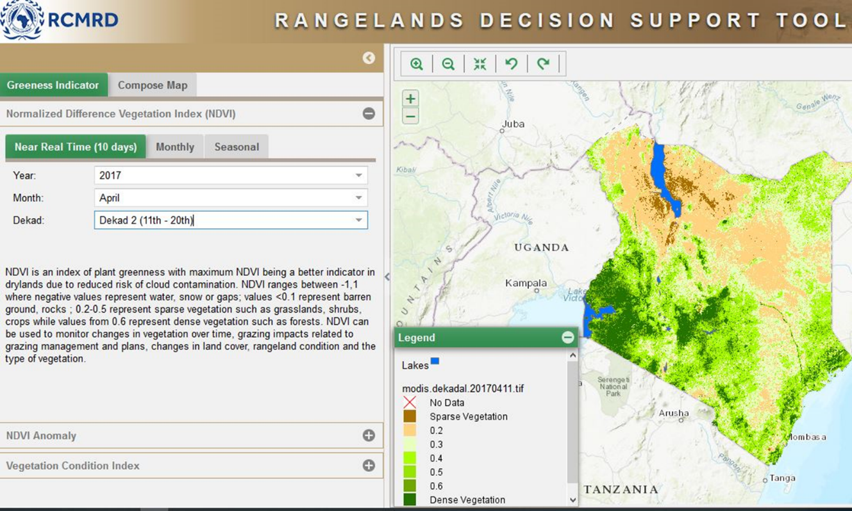
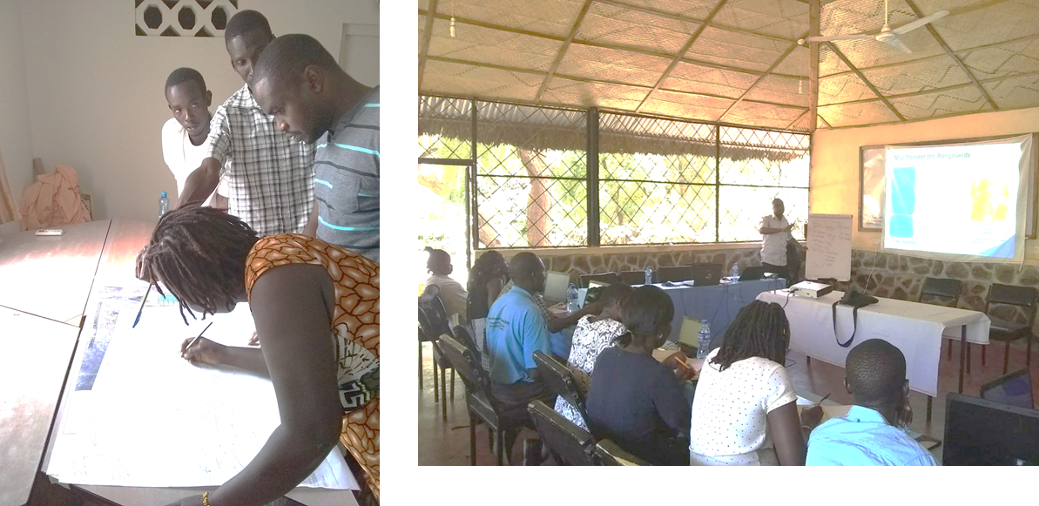
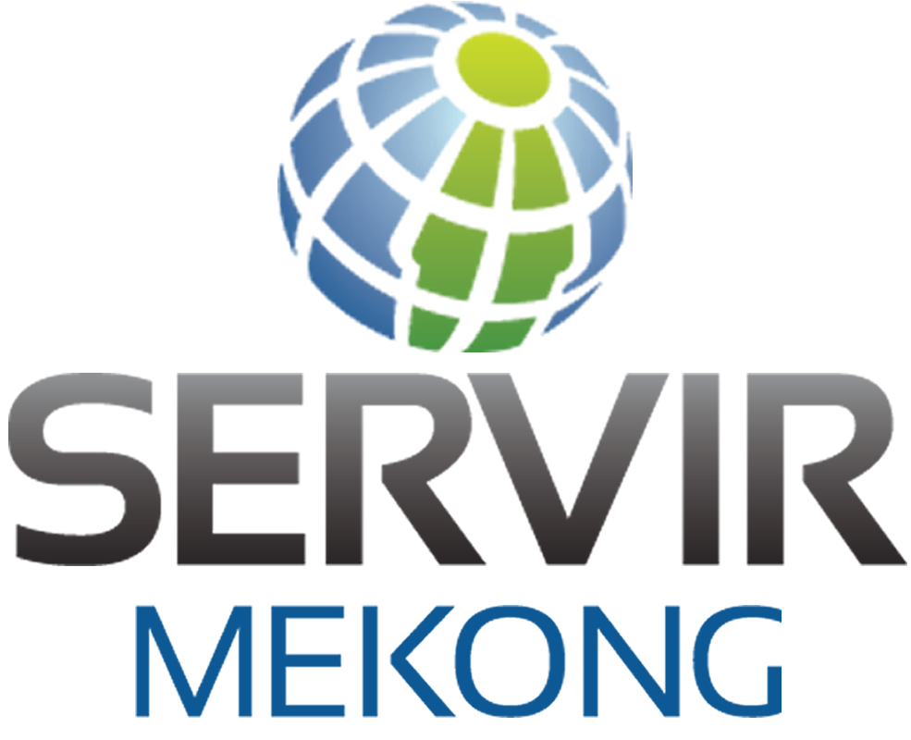
Kenya Rangelands Productivity Assessment and Monitoring
Agriculture &
Food Security
Training
Beta Testing
Consultations
Fieldwork
Operationalization
Needs Assessment
Stakeholder Mapping
Service Planning Dev.
Consultation/Needs Assess.
Web based Tool Beta version
Web based Tool
Problem specification
Arid and semi-arid rangelands comprise 80% of Kenya’s land mass, contain 70% of the country’s livestock population, and generate 90% of tourism revenue. The rangelands are under continuous threat due to climate variability coupled with rapidly growing livestock and human populations. Extreme events are also increasing in intensity and frequency, resulting in notable declines in productivity in the rangelands due to shorter recovery time. With dependence on rain-fed pastures, better management of the rangelands require near real time information on vegetation conditions and availability of water.
Use Case / Highlights
Service Use Case:
Selected Indicators / Metrics:
Theory of Change
“Don’t panic! The tool will allow me to reassure management on the resilience of the Lewa Ecosystem. From the maps I can clearly show what they had assumed to be degradation, was actually vegetation loss from the drought(2017) and the vegetation recovered fully when the rains came(2018)” David Kimiti- Head of Research and Monitoring, Lewa Conservancy
“Our current grazing plans, due to frequent droughts had resulted in in poor vegetation conditions especially in Leparua area. Using the maps, we have been able to confirm the areas which are degraded and developed a new plan which we will present to management for review” Sammy Tema- NRT Grazing Coordinator for Il-Ngwesi Conservancy
Assumptions: That the tools outputs will be accurate and that stakeholders will use the tool for decision making.
Inputs: Stakeholder consultations, methodology and tool development, trainings, dissemination, data (Modis NDVI, surface water maps, invasive species maps, monitoring unit boundaries, ancillary data (roads, rivers, place names)).
Outputs: Dekadal, monthly and seasonal NDVI, absolute and standardized anomalies, VCI, reports from stakeholder consultations, fully functional web-based tool, number of stakeholders trained, training manual and maps.
Outcomes: Improved capacity of stakeholders to use web based tool for decisions making on rangelands
Impact: Improved rangeland productivity
Goal
Development of a dynamic web-based tool for assessment of vegetation conditions and availability of water to provide timely information for decision making in the rangelands. The tool seeks to inform decisions on management of available pastures in dry and wet seasons, development of proper grazing plans, informing livestock movement in planned grazing areas, implementation of conservation measures meant to rehabilitate degraded lands, management of scarce water resources and mitigation of the spread of invasive species.
Figure 7: Participants during workshops
Key stakeholders
Decision makers: Northern rangelands Trust (NRT) and Laikipia Wildlife Forum (LWF) – conservancy owners/managers, Kenya Rapid, National Drought Management Authority (NDMA), County governments, rangelands management committees
Users: Northern Rangelands Trust (NRT), Laikipia Wildlife Forum (LWF), National Drought Management Authority (NDMA), FEWSNET, Kenya Wildlife Service, Centre for Training and Integrated Research in ASAL Development (CETRAD), Kenya RAPID (under Partnerships for Resilience and Economic Growth (PREG))
Beneficiaries: NDMA county officers, Local communities, grazing coordinators, conservancy managers, local conservation groups, ranch owners and managers
Service integration: Inputs from invasive species modelling
Legend:
Yellow: Decision makers, data collectors, providers, analyzers, enablers
Blue: Decision Makers, Intermediaries and enablers
Green: Data collectors, providers, analyzers, enablers
Cyan: Users/Beneficiaries
Figure 2: Maps generated to allay panic and reassure management of the resilience of conservancy
Figure 3: Maps generated to make the assessment for IlNgwesi Conservancy
Figure 4: Proposed revised map for Il-Ngwesi Conservancy developed during the training by the NRT team
Science Collaborations, Earth Observations, Models, and Methods
Figure 1: Methodology workflow and the web based interface
Fully automated and operational tool capable of pulling data, processing and publishing final outputs
With support from Kenya RAPID, RCMRD/SERVIR E&SA supported counties in digitization of grazing plans (approx. 10 maps developed)
3 counties through stakeholders financed further trainings for their rangeland stakeholders
Approx. 70 stakeholders trained in application of the tool for decision making
NDMA to finance data collection for validation of surface water and also in co-assessment of RHEAS drought outputs
55 NDMA officers engaged in a sensitization workshop on the tool where plans for data collection for validation were made
Figure 8: Growth in Stakeholders Network following CNA and Stakeholder Consultations
Immediate Next Steps
Support for the index-based livestock insurance program together with SCO and stakeholders (ILRI, State Department of Livestock)
Implementation of the Quality Insurance Index Certification standard (QUIIC) together with UC-Davis
Engagement of newly- identified and interested stakeholders
Consolidation of feedback from stakeholders as an input to improvement of the tool
Data collection for validation in collaboration with NDMA
Continued capacity building and sensitization of grassroots/county stakeholders in collaboration with Kenya RAPID
Engagement with other hubs and SCO to improve the tool’s functionality
Improve the NDVI utilization component
Incorporation of the surface water monitoring component into the tool with support from SCO
Figure 5: Digitized wet and dry grazing area maps for parts of Isiolo County
Figure 6: Sensitization and digitization of grazing areas in Turkana

