Slide 1
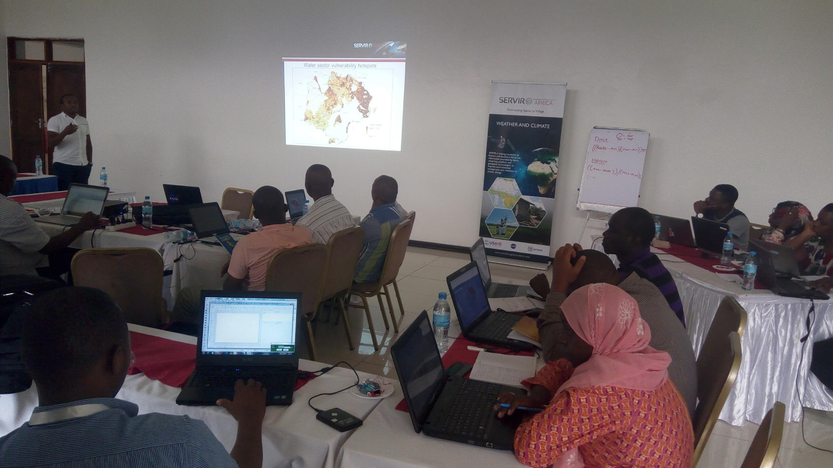
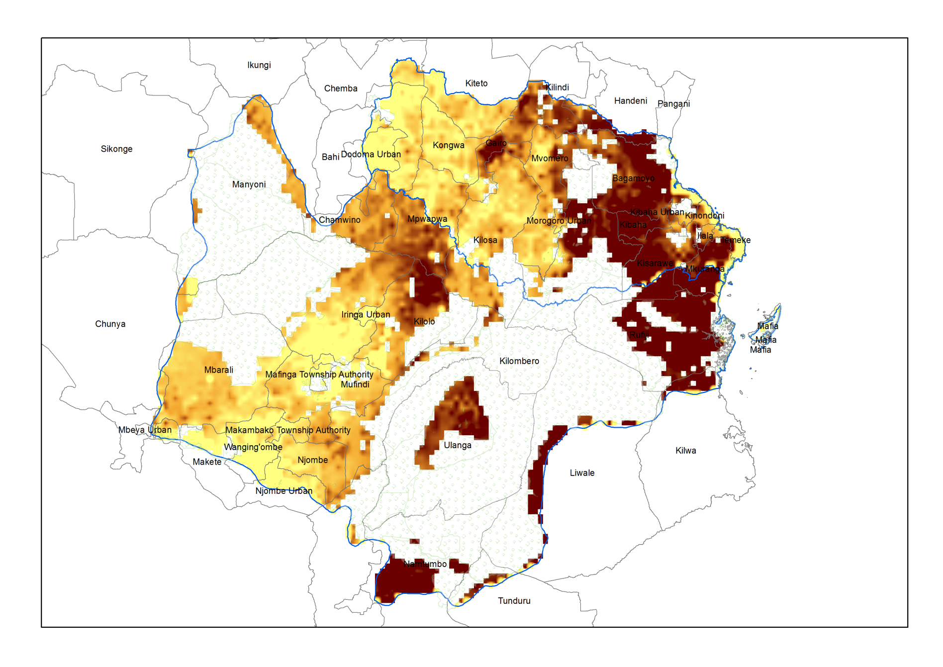
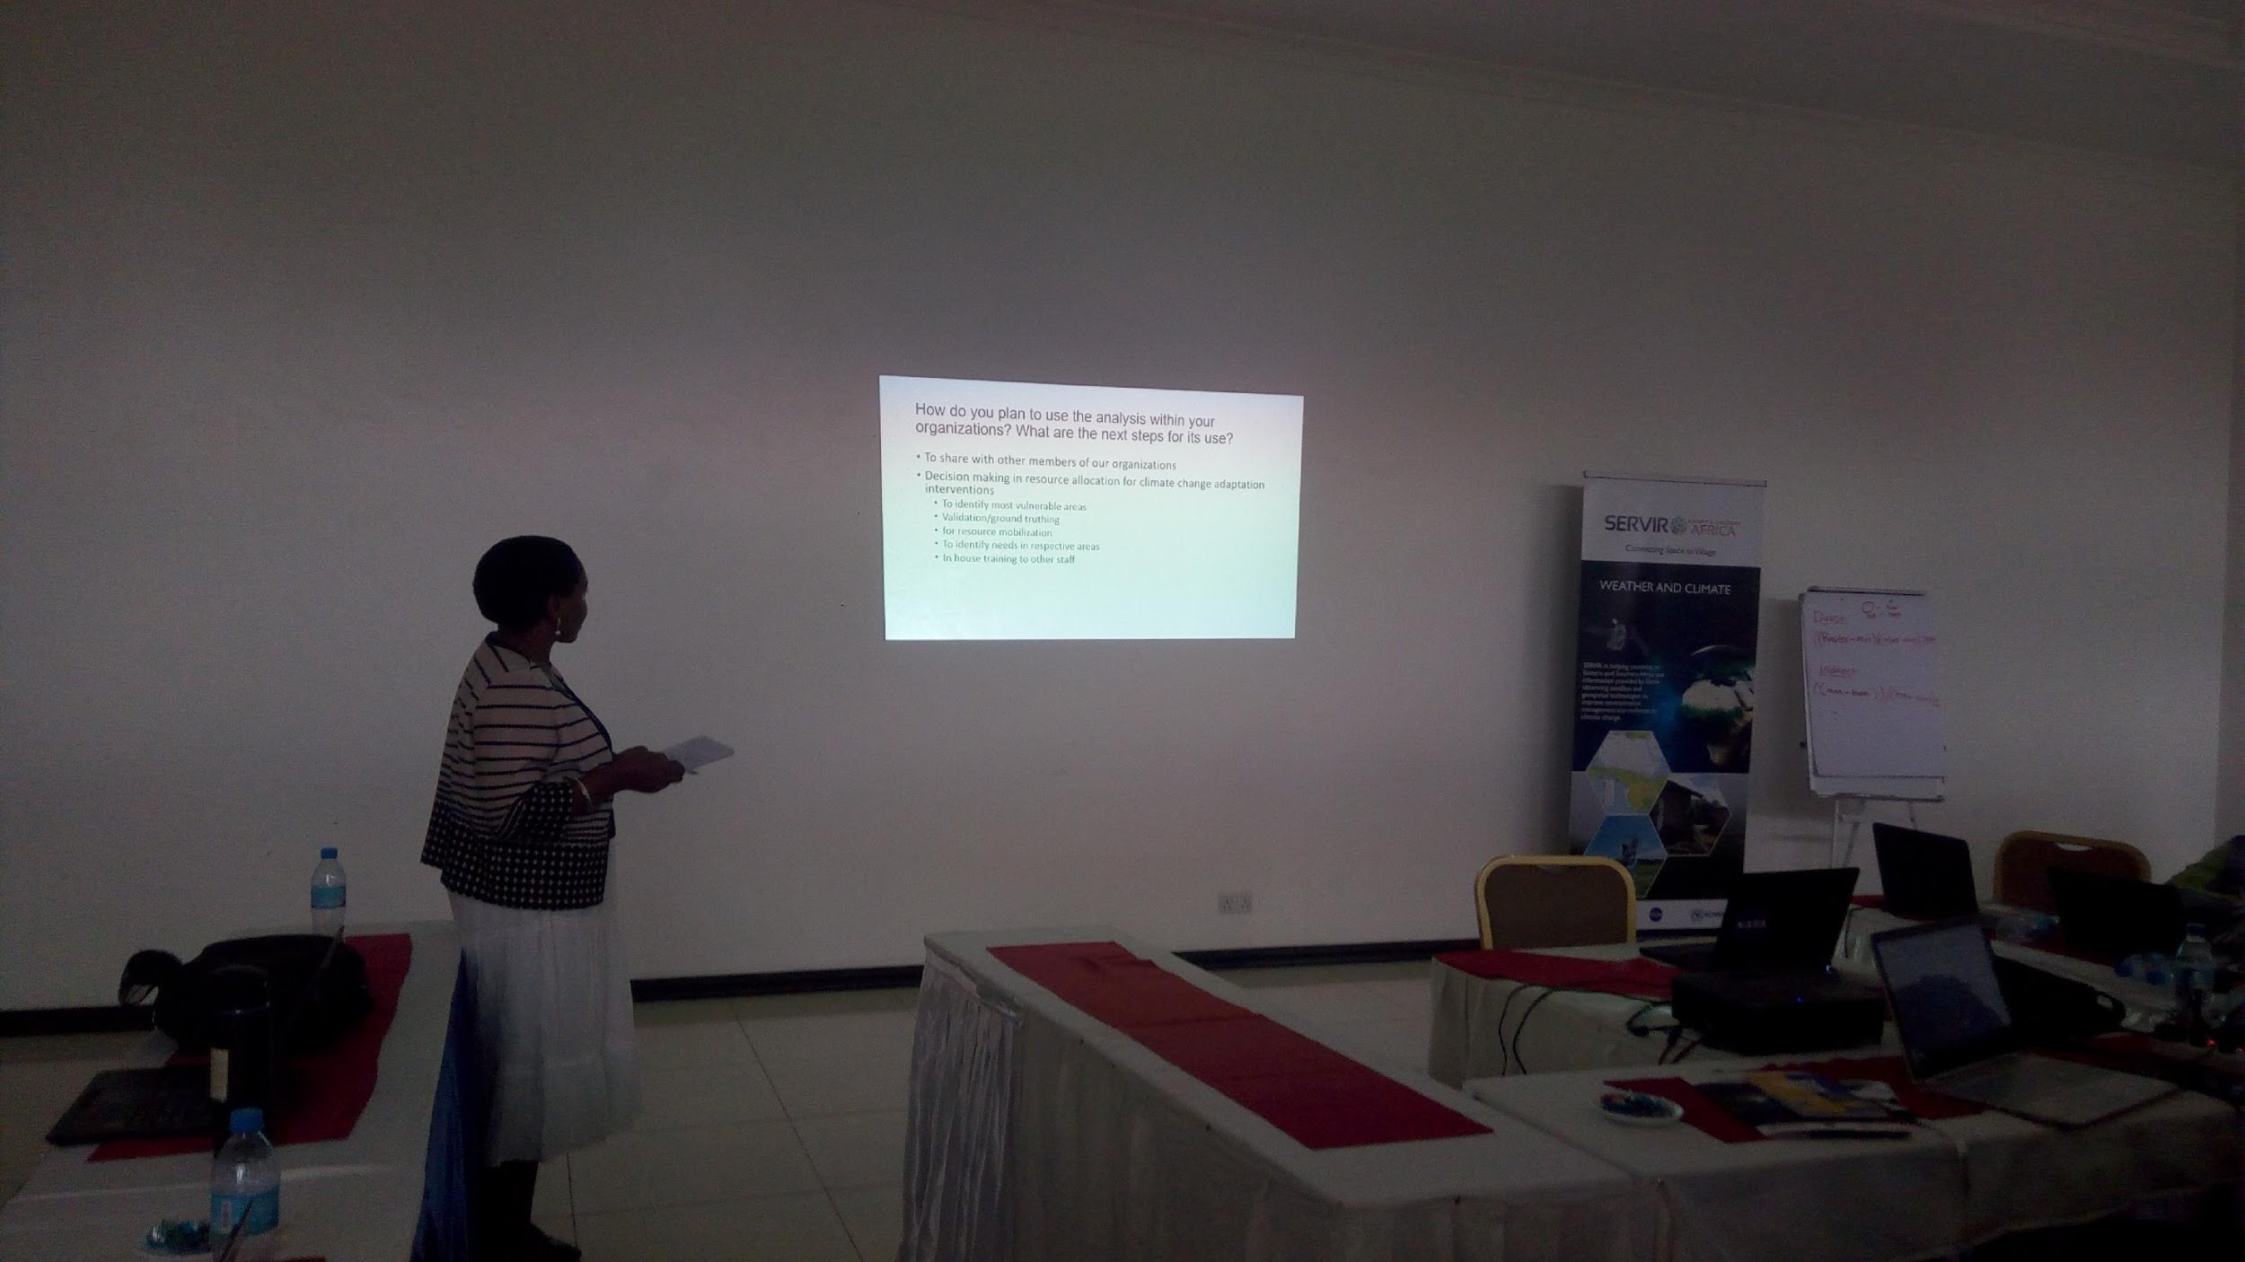
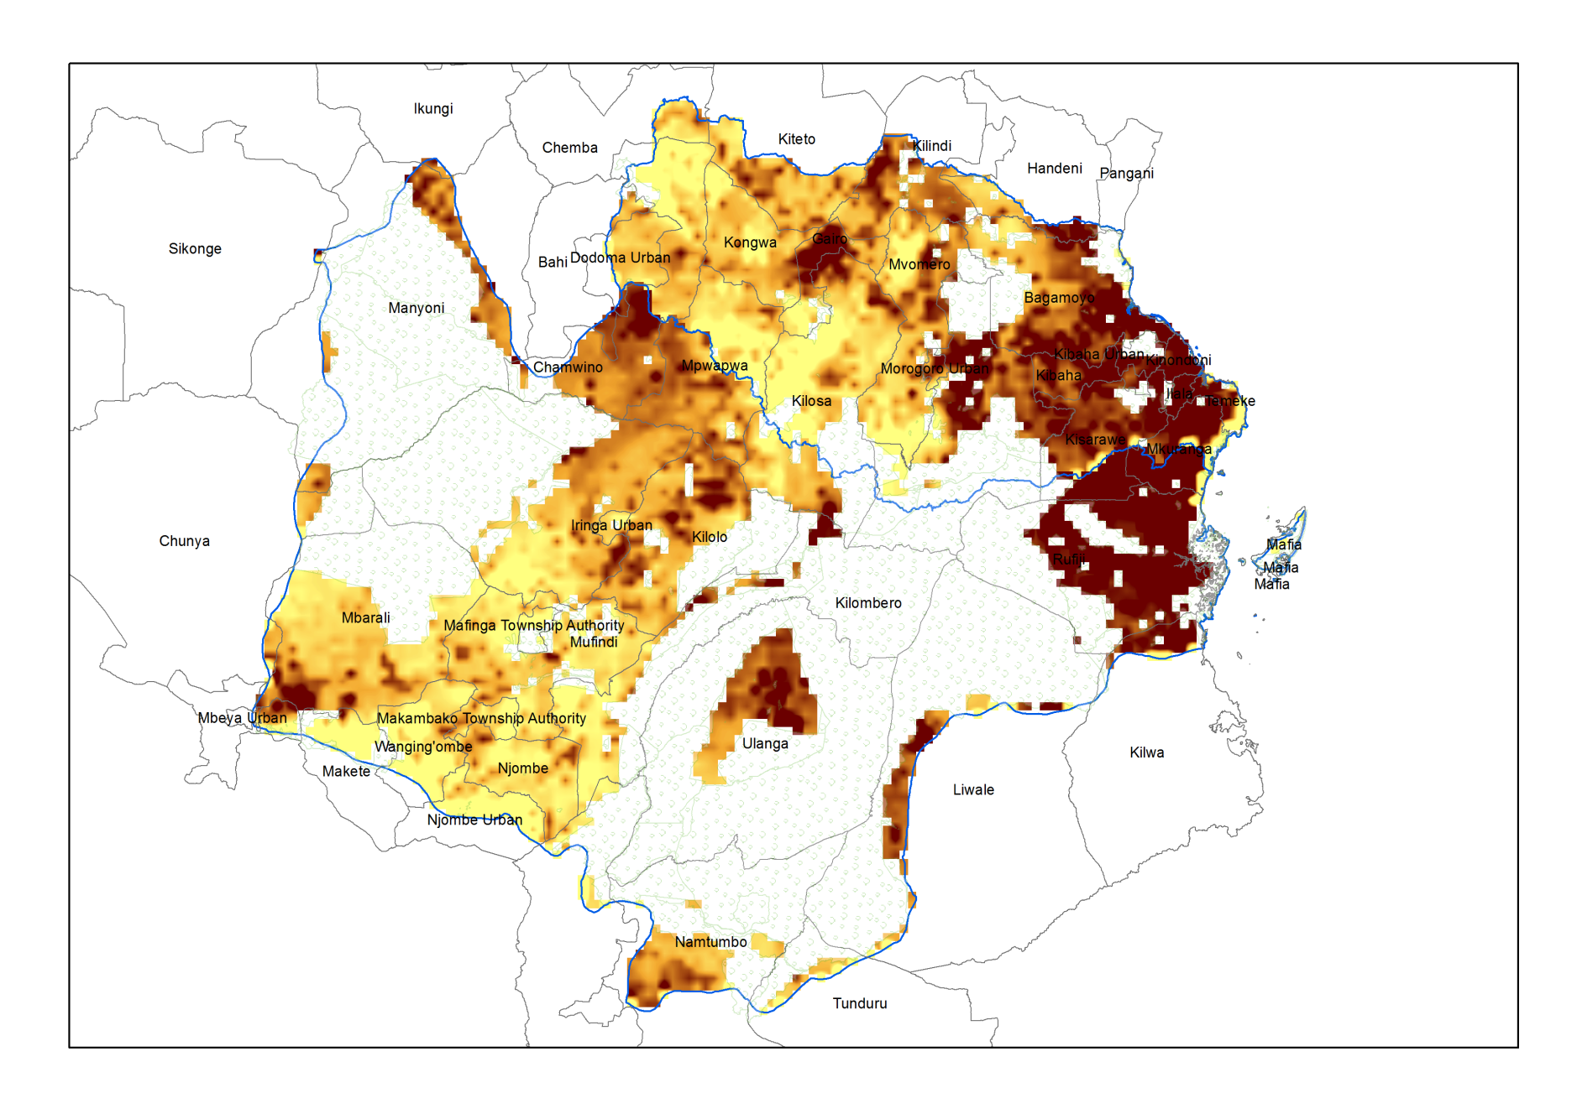
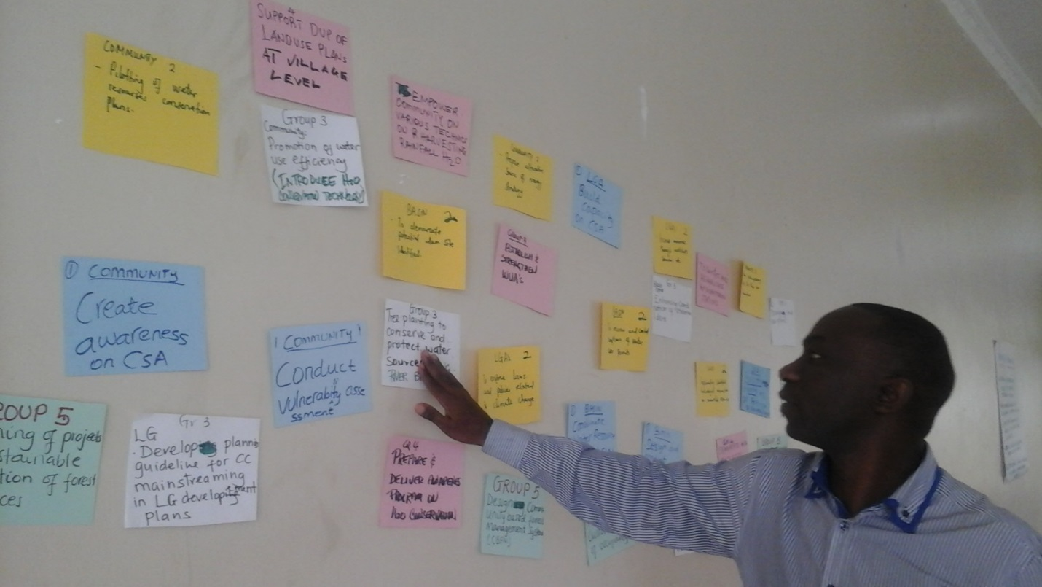
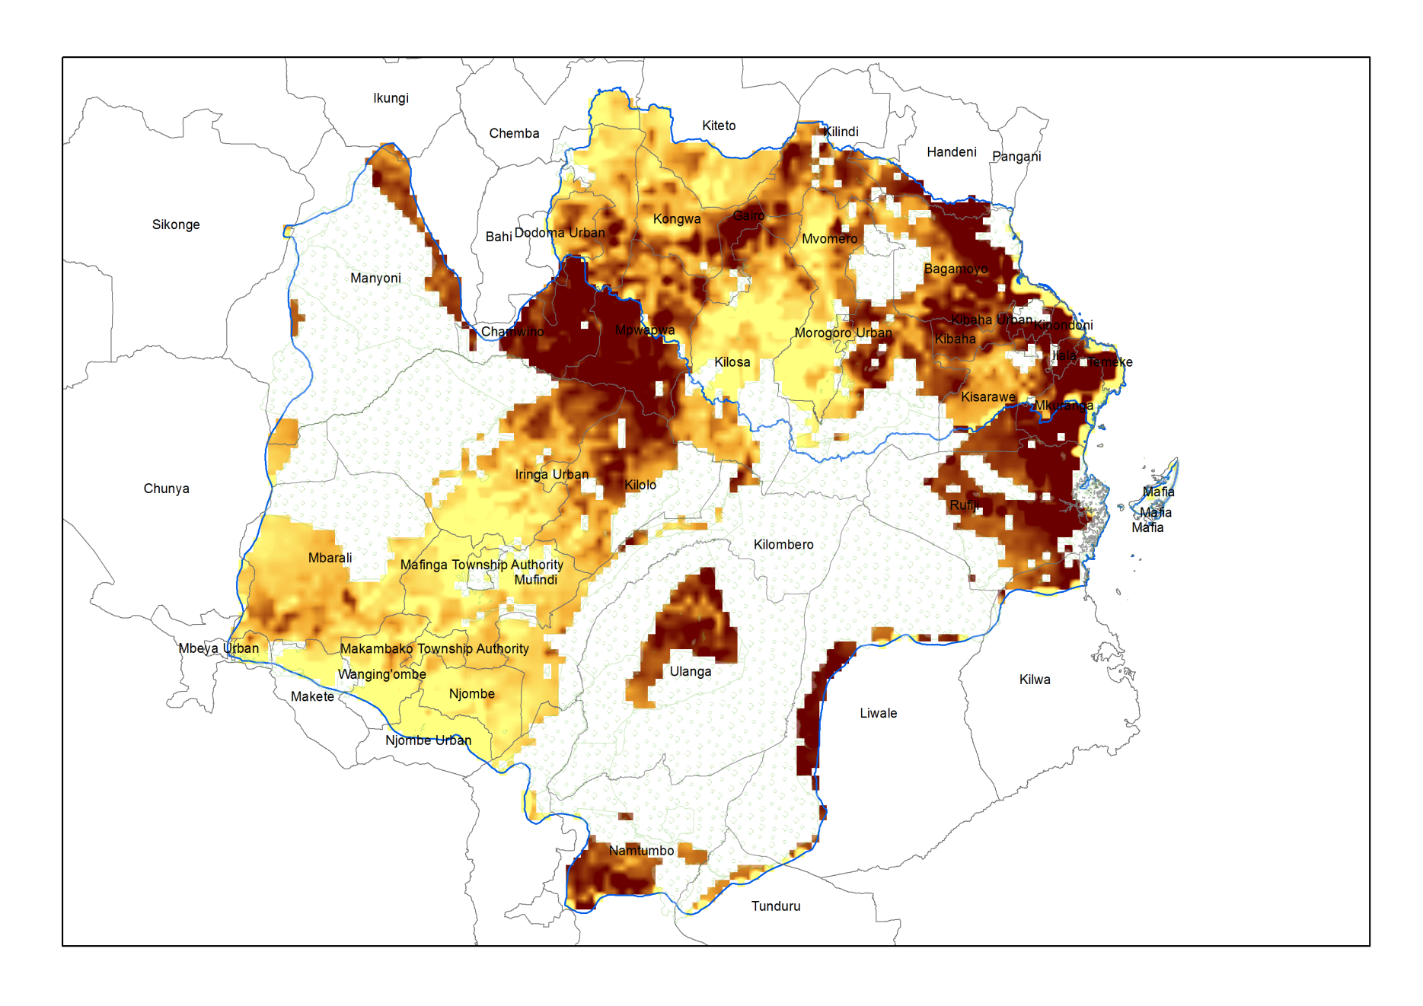
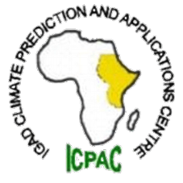
Weather and
Climate
Integrated climate and disaster vulnerability, impacts and assessments
Problem specification
Climate variability and change in the rangelands of Kenya and in major river basins in Tanzania is likely to significantly alter the functioning of the rangelands and their ability to support community livelihoods and biodiversity as well as the availability and quality of surface and groundwater resources. Vulnerability assessments have principally focused on assessing social vulnerability. Limited work has been carried out to understand the spatial exposure and sensitivity of differing ecosystems, and communities to climate variability as well as their adaptive capacity, or the ability of key institutions to anticipate, reduce, and for ecosystems to withstand and respond to climate-related impacts.
Highlights
Sectoral hotspots maps developed: rainfed agriculture, communities, and water resources
20 experts from the co-development team trained on vulnerability index mapping
10 districts selected by WARIDI using the hotspots maps to implement FY2018 resilience building activities
Service Tracker
Initial needs assessments done at service area level
Follow on consultations done at service level with key stakeholders
Joint completion of the SC done with WARIDI and a joint activity implementation schedule agreed upon
CNA/S
SC
PDD
TDD
DSDD
Goal
The overarching goal of this service is to work with service co-implementing partners and decision makers in Tanzania and Kenya to apply and integrate climate exposure and vulnerability information in the development and application of resilience measures and strategies to reduce water risks, resource use conflicts, ecosystem degradation and loss of livelihoods.
Selected Indicators / Metrics
Key stakeholders
Decision makers: NRT Conservancies managers, grazing coordinators, Wami-Ruvu, Rufiji and Mara River basin water boards, government ministries
Users: Meteorological services, water and irrigation agencies, basin water offices
Beneficiaries: Pastoralists, and basin water user groups (farmers, fishers, power generators, communities)
Special audiences: Women and girls, marginalized pastoral communities
Indicator | #
Number of people trained in climate change adaptation supported by USG assistance | 146
Number of institutions with improved capacity to address climate change issues as supported by USG assistance | 4
Number of regional stakeholders co-developing climate mitigation and/or adaptation tools, technologies, and methodologies | 4
Theory of Change
Assumptions:
The need for this service will be existent throughout the service implementation period and key stakeholders and partners will continue to support the project
Inputs:
Outputs:
Vulnerability maps
Land use land cover change maps
Capacity assessment reports
Peer reviewed methodology paper
Training manuals
Outcomes:
Increased provision of user-tailored geospatial data, historical and projected vulnerability hotspots maps, climate vulnerability index mapping tool, land cover and land use maps.
Improved capacity of basin offices and water users in Wami Ruvu, Rufiji and Mara River basins to implement integrated water resources plans and communicate climate and disaster risks to basin water users.
Improved capacity of Northern Rangelands Trust and key stakeholders to implement a climate and disaster strategy for the Northern Rangelands.
Impact:
Reduced climate and disaster risks to water resources and livelihoods.
Earth Observations / Models / Methods
Climate data: CHIRPS precipitation, CHIRTS temperature, CORDEX downscaled GCM
Environmental data: Vegetation, land cover, malaria susceptibility
Socio-economic data: Poverty, population access to water, health and market services, agriculutral productivity, education, land use plans
Hazards data: Floods, droughts, wild fires
Data Acquisition, stakeholder consultations and training
Data processing & analysis, product co-development and validation
Products dissemination and integration into decision making processes
Immediate Next Steps
Stakeholder mapping
Completion of the PDD and TDD
Completion of the baseline hotspots mapping methodology paper
Looking forward
We are still facing challenges getting a reliable temperature dataset (minimum and maximum temperature) and although this challenge is being addressed by UCSB/CHG, we’d need to accelerate the pace of developing the dataset.
Opportunities are arising for gridding station data with satellite data through SERVIR E&SA collaboration with TAHMO and GLOBE. A future collaboration to develop a gridded dataset analogous to CHIRPS and CHIRTS will be explored in FY2018
Contributions from AST
UCSB is providing access to climate datasets (CHIRPS and CHIRTS) and data analysis tools ( EWX)
Plans to hold a technical training on applied climate data analyis for WARIDI partners in Tanzania (early 2018)
UCSB providing GeoCLIM/CHIRPS/CHIRTS-compatible downscaled Global Climate model projections from CORDEX
Statistical climate projections from UCSB using the GeoMOD tool for Tanzania
Beginning ARL: ___ Current ARL: ___ Final ARL: ___

